Slide 1
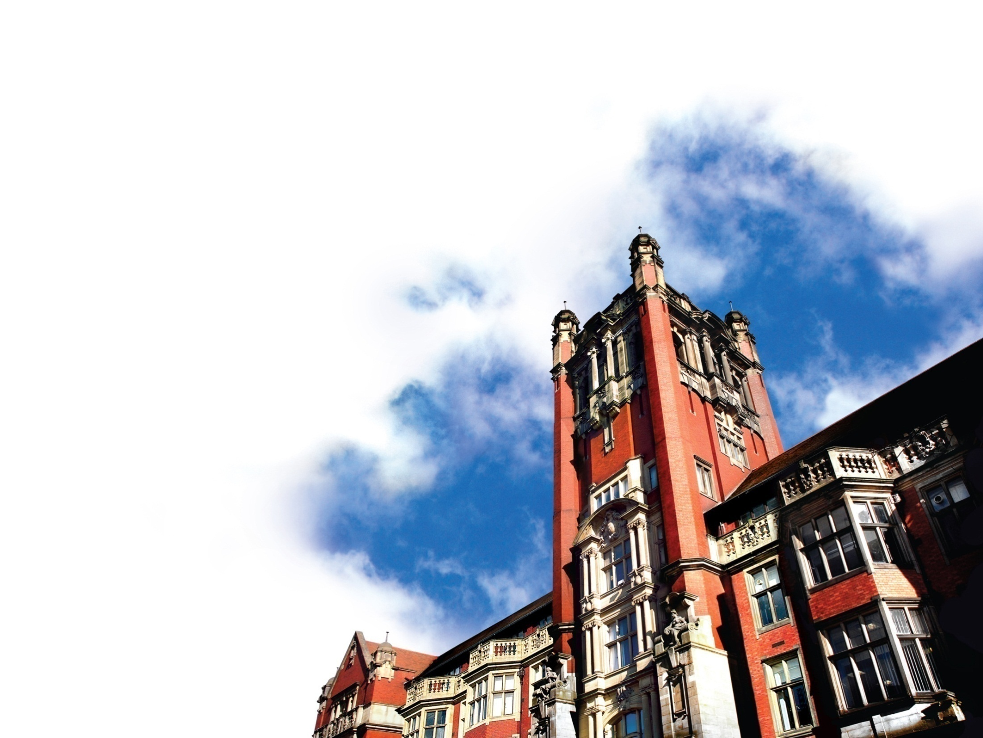
Student transitions
Professor Peter Hopkins

Slide 2
Schedule
Introduction
Group work: thinking through student transitions
Group feedback
Thinking through social and academic issues in the transition to, through and from university
Questions

Slide 3
Transitions to, through and from university
Transitions
To (starting university, experiences in the period before and after starting university) (induction)
Through (from one year/level to the next, one from semester/term to the next, to dissertation, etc)
From (onto Masters, PCGE, into the labour market, etc) (outduction)
Academic transitions (Lectures, seminars, workload and assessment expectations, dissertation etc)
Social transitions (personal life, friendships and relationships, housing, work, family etc)

Slide 4
Transitions to university
Academic
Learning a new system (e.g. deadlines, word limits, referencing, tutors, colleges, departments, library etc)
Taking responsibility
University tends to be far more flexible than school
Possible difference between focus and nature of subject and how it is taught at university compared to school
Finding out how difficult it is to get a ‘good’ mark
Critical thinking
Learning to use multiple sources
Speaking out in larger groups
Fitting in with your tutorial/seminar group
No longer being the higher achiever
No longer being ‘spoon fed’

Slide 5
Transitions to university
Social
Making new friends. New people etc.
Moving home and settling in
Cooking, washing and life skills
Not having someone looking over their shoulder
First in family to go to university?
Pressure to perform well (e.g. family pressure, gendered or ethnicised assumptions)
Financial security, emotional well-being security
Managing part-time work and study
Managing sport and leisure commitments with study
Relationships – making and breaking
Creating a routine
Having a regional accent
Student culture (drinking culture, peer pressure, campus relations)

Slide 6
Transitions through university
Academic
2.1 pressure
Finding their academic voice
Being strategic (what do I need to know to pass?)
Exchange programmes or placements
Original thinking
Becoming a partner in learning
Optional modules
Missing a year or changing cohorts
Raising standards each semester/term/year

Slide 7
Transitions through university
Social
Moving accommodation
Changing friendships (e.g. friends move course or accommodation)
Coming back from a long vacation
Financial issues (e.g. work, rent etc)
Student culture
And the social issues mentioned in the transition to university may still be around or intensified.

Slide 8
Transitions from university
Academic
2.1 pressure
Should I do a Masters?
Careers support
Looking and acting like a professional
Disconnecting from university
Knowledge transfer
Social
Loss of friends and security
Moving again
Job panic
Debt
Culture shock

Slide 10
Research
Participatory diagramming and group discussions with Geography undergraduate students
Individual interviews with Geography undergraduate students
Thinking about the transition to, through and from university
Thinking about teaching and learning
Thinking about living at home
Followed 3 cohorts of students through the degree programme interviews them two or three times (49 interviews in total)

Slide 11
Critical moments
A critical moment is an event mentioned in a research encounter ‘that either the researcher or the interviewee sees as having important consequences for their lives and identities’ (Thomson et al, 2002: 339).
May include major life events (e.g. starting university) or events not always thought of as particularly significant (e.g. changing friendship group).
Some critical moments are literally moments whereas others can last much longer.
Some may be agonised over and considered in great depth, yet others could be small decisions made without much thought or consideration.

Slide 12
FAMILY Passing driving test
Being kicked out of home ‘Coming out’
Parents splitting up Religious conversion
Disclosing abuse TROUBLE
Father remarrying Getting caught taking drugs (‘busted’)
Falling out with step parents Getting arrested
Parental unemployment Getting pregnant
Disowned by mother Father going to jail
DEATH AND ILLNESS Getting into drugs
Death of a parent LEISURE AND CONSUMPTION
Aunt committing suicide Becoming involved in gay community
Loss of a baby Joining amateur dramatic society
Diagnosis of dyslexia Starting to go to the pub
Diagnosis of chronic illness Going clubbing
Death of grandparents Getting a mobile phone
Depression Getting a car
EDUCATION MOVING
Sitting GSCE exams Moving town
Choosing GSCEs Moving house
Failing GSCE exams Moving country
Dropping out of school/college RELATIONSHIPS
Excluded from school New boyfriend
Bullying at school Falling out with best friend
Changing/leaving school Making new friends
Starting college Being excluded from friendship group
Careers Advice Changing friendship group
Conflict with teacher Breaking up with girlfriend
RITES OF PASSAGE Girlfriend going to university
18th birthday Sexual experience
(Thomson et al, 2002: 341)

Slide 13
What would you say are three of the most significant critical moments that have occurred in your life?
George
As I’ve mentioned above, my parents split up just as I was preparing to begin university, which had some major consequences on my life. When I first made the decision to go to Newcastle, I obviously hadn’t expected any of this, and I’ve often wondered whether I would I have made the same decisions had I known what was about to happen
After my first year at university, I felt that my lack of confidence was holding me back a lot, and I resolved to get help to try and conquer my shyness, so I went to see a doctor. I think to an extent I did improve, and by second year I felt much more confident in and around university. However, this was arguably shutting the door after the horse had bolted, as it was first year when most friendships seemed to be made. Still, it made a huge difference on my life
I find it difficult to think of specific ‘critical moments’ in my life, as I don’t think there have been many individual incidents which have had a particularly huge impact on my life. Most relevant examples I can think of took place over a large period of time, such as the way I was treated by my dad (which affected my self esteem), my experiences of school (which were often difficult) etc
Andrea
1. Started seeing my boyfriend in semester 2 of first year.
2. Preparing for and having my interview for PGCE
3. Moving home to start university

Slide 14
What would you say are three of the most significant critical moments that have occurred in your life?
Lyndsey
1 Carrying out independent research in a country where English was not the first language
2 Graduating with a first after so much hard work, but in particular, getting a high mark in the essay I cared most about.
3 Talking in the seminar in front of other academics.
Andrea
1. Death of my grandfather – disrupted some of my first year study
2. Boyfriend – positive encouragement and support
3. Moving away from home and living independently – managing my own time/study

Slide 15
Emerging themes …
Most local students are not widening participation students.
Recruiting local students: school visits (with amenable teachers) more successful than open days. Need personal reassurances.
Still felt perception of Newcastle as a “snobbish” university – many feel this to be case throughout their degree but are prepared to put up with this to get a “good degree”
Family and close friends encouraged students to stay local.
Teachers sell the idea of moving away for the “full uni experience”
Many local students articulated a strong sense of isolation (particularly at the start of their first year).
often local friends had moved away.
Having a regional accent can heighten this sense of isolation
induction processes and early residential fieldcourses important for countering this.
Local students tend to befriend other local students – but don’t see polarisation of cohort as a problem.
Can be challenging when having to travel far for lectures
Upon graduation, prepared to move out of NE for employment – but not as flexible as other students, e.g. anti-London sentiment expressed.

Slide 16
Social and academic transitions
Critical moments included a mix of academic and social issues (but more of the latter)
Social aspects of transitions are regarded as very important by students – in particular, how these affect confidence at university and shape academic transitions.

Slide 17
Some other suggestions……
Early interventions - pre-induction, mentoring and
extended inductions (induction doesn’t just last a week or so)
Social networking – can start to use this before students arrive at university
Bespoke session in induction programme for WP students
Early fieldtrips/group activities to help students to get to know each other
Timetable flexibility (e.gs seminar groups, tutor groups)
Participatory teaching can aid transition

Slide 18
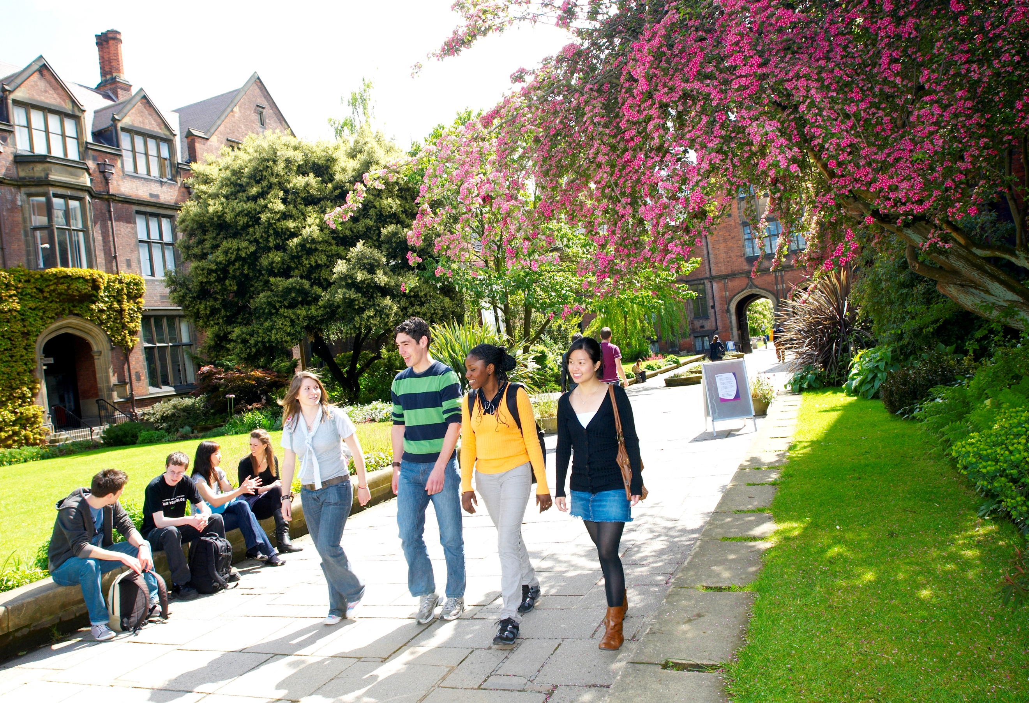
Thanks for listening
http://research.ncl.ac.uk/studenttransitions

